Slide 1
No Local Reuse
조현종, 박찬식
Soc Design Lab, Konkuk Univ.
19/08/15
Notes:
이번에 발표할 프로젝트는 자일링스 Sw Alexnet을 통해 pcam5c 카메라 모듈의 이미지를 classification 하는 프로젝트입니다.

Slide 2
Outline
Design
Calculation Optimization
Memory Access Optimization
Computation Order
Dataflow

Slide 3
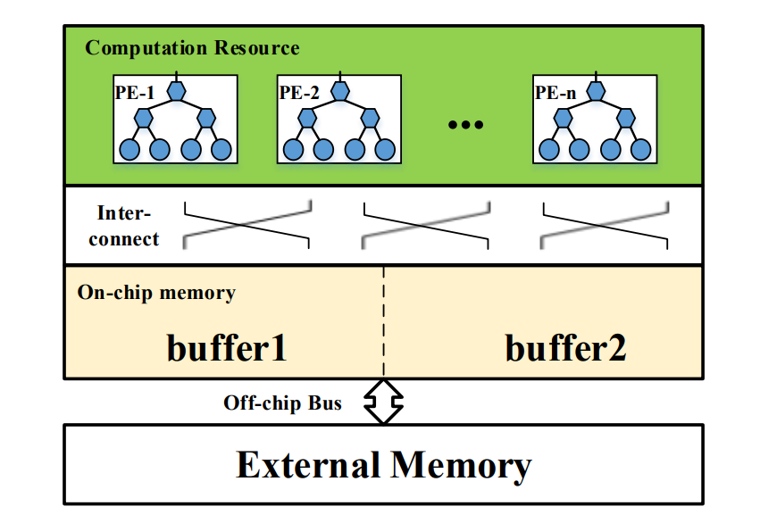
Design
Overview

Slide 4
Design
Overview
for(e=0; e<E; e+=Te){
for(f=0; f<F; f=Tf){
for(m=0; m<M; m+=Tm){
for(c=0; c<C; c+=Tc){
//On-chip data computation
for(s=0; s<S; s++){
for(r=0; r<R; r++){
for(te=e; te<min(e+Te,E); te++){
for(tf=f; tf<min(f+Tf,F); tf++){
//unroll
for(tm=m; tm<min(m+Tm,M); tm++){
for(tc=c; tc<min(c+Tc,C); tc++){
ofmap[tm][te][tf]+=
fmap[tm][tc][s][r]*
ifmap[tc][te+s][tf+r]
}}
}}}}
}}}}
for(e=0; e<E; e++){
for(f=0; f<F; f++){
for(m=0; m<M; m++){
for(c=0; c<C; c++){
for(s=0; s<S; s++){
for(r=0; r<R; r++){
ofmap[m][e][f]+=
fmap[m][c][s][r]*
ifmap[c][e+s][f+r]
}}}}}}
Convolution Ref.
Convolution Opt.

Slide 5
Design
Overview
Computation Optimization
Loop Tiling
Loop Unrolling
Loop Interchange
Memory Access Optimization
Local Memory Promotion

Slide 6
Calculation Optimization
Loop Tiling
루프 타일링은 칩 내부에서 연산하는 데이터를 작게 만들어 주기 위한 필수 과정
for(e=0; e<E; e+=Te){
for(f=0; f<F; f+=Tf){
for(m=0; m<M; m+=Tm){
for(c=0; c<C; c+=Tc){
for(te=e; te<min(e+Te,E); te++){
for(tf=f; tf<min(f+Tf,F); tf++){
for(tm=m; tm<min(m+Tm,M); tm++){
for(tc=c; tc<min(c+Tc,C); tc++){
for(s=0; s<S; s++){
for(r=0; r<R; r++){
ofmap[tm][te][tf]+=
fmap[tm][tc][s][r]*
ifmap[tc][te+s][tf+r]
}}}}}}
}}}}
for(e=0; e<E; e++){
for(f=0; f<F; f++){
for(m=0; m<M; m++){
for(c=0; c<C; c++){
for(s=0; s<S; s++){
for(r=0; r<R; r++){
ofmap[m][e][f]+=
fmap[m][c][s][r]*
ifmap[c][e+s][f+r]
}}}}}}

Slide 7
Calculation Optimization
Loop Unrolling & Interchange
Loop Unrolling을 통해 PE의 개수를 늘려 FPGA의 리소스 사용을 최대화 시킬수 있다.
Unrolling하는 루프에 따라 하드웨어의 복잡도가 달라지게 된다.
te, tf, s, r은 ifmap에 동시에 영향을 주어 언롤링 시 복잡도가 올라감
tm, tc 루프를 언롤링할때 가장 간단한 회로가 생성된다.
ofmap[tm][te][tf] += fmap[tm][tc][s][r] * ifmap[tc][te+s][tf+r]

Slide 8
Calculation Optimization
Loop Unrolling & Interchange
for(te=e; te<min(e+Te,E); te++){
for(tf=f; tf<min(f+Tf,F); tf++){
for(tm=m; tm<min(m+Tm,M); tm++){
for(tc=c; tc<min(c+Tc,C); tc++){
for(s=0; s<S; s++){
for(r=0; r<R; r++){
ofmap[tm][te][tf]+=
fmap[tm][tc][s][r]*
ifmap[tc][te+s][tf+r]
}}}}}}
for(s=0; s<S; s++){
for(r=0; r<R; r++){
for(te=e; te<min(e+Te,E); te++){
for(tf=f; tf<min(f+Tf,F); tf++){
for(tm=m; tm<min(m+Tm,M); tm++){
#pragma HLS UNROLL
for(tc=c; tc<min(c+Tc,C); tc++){
#pragma HLS UNROLL
ofmap[tm][te][tf]+=
fmap[tm][tc][s][r]*
ifmap[tc][te+s][tf+r]
}}}}}}

Slide 9
Calculation Optimization
Result - Computation Engine
PE
Tc*Tm
for(tm=m; tm<min(m+Tm,M); tm++){
#pragma HLS UNROLL
for(tc=c; tc<min(c+Tc,C); tc++){
#pragma HLS UNROLL
ofmap[tm][te][tf]+=
fmap[tm][tc][s][r]*
ifmap[tc][te+s][tf+r]

Slide 10
Memory Access Optimization
Local Memory Promotion
Ofmap은 가장 안쪽 루프인 C와 관계없으므로 로드 스토어를 하지않아도 됨
for(e=0; e<E; e+=Te){
for(f=0; f<F; f=Tf){
for(m=0; m<M; m+=Tm){
for(c=0; c<C; c+=Tc){
//load ofmap
//load weights
//load ifmap
//OnChip Computation
L: foo(ofmap[tm][te][tf],
fmap[tm][tc][s][r],
ifmap[tc][te+s][tf+r])
//store ofmap
}}}}
for(e=0; e<E; e+=Te){
for(f=0; f<F; f=Tf){
for(m=0; m<M; m+=Tm){
for(c=0; c<C; c+=Tc){
//load weights
//load ifmap
//OnChip Computation
L: foo(ofmap[tm][te][tf],
fmap[tm][tc][s][r],
ifmap[tc][te+s][tf+r])
}
//store ofmap
}}}

Slide 11
Computation Order
#0 Init
for(s=0; s<S; s++){
for(r=0; r<R; r++){
for(te=e; te<min(e+Te,E); te++){
for(tf=f; tf<min(f+Tf,F); tf++){
#unroll
for(tm=m; tm<min(m+Tm,M); tm++){
for(tc=c; tc<min(c+Tc,C); tc++){

Slide 12
Computation Order
#1

Slide 13
Computation Order
#2

Slide 14
Computation Order
#3

Slide 15
Computation Order
#4

Slide 16
Computation Order
#5

Slide 17
Computation Order
#6

Slide 18
Computation Order
#7

Slide 19
Computation Order
#8

Slide 20
Computation Order
#9

Slide 21
Computation Order
#10

Slide 22
Computation Order
#11

Slide 23
Computation Order
#12

Slide 24
Computation Order
#13

Slide 25
Computation Order
#36

Slide 26

DataFlow
Timing Graph
phases
Load
Store

Slide 27
DataFlow
#1 phase
C=256 ,Tc=2 -> 128 phases needed!
Variable: c=0; m=0;
Load – ifmap, fmap
phases
Store – ofmap

Slide 28
DataFlow
#2 phase
C=256 ,Tc=2 -> 128 phases needed!
Variable: c=2; m=0;
Load – ifmap, fmap
phases
Store – ofmap

Slide 29
DataFlow
#3 phase
C=256 ,Tc=2 -> 128 phases needed!
Variable: c=4; m=0;
Load – ifmap, fmap
phases
Store – ofmap

Slide 30
DataFlow
#128 phase
C=256 ,Tc=2 -> 128 phases needed!
Variable: c=254; m=0;
Load – ifmap, fmap
phases
Store – ofmap

Slide 31
DataFlow
#129 phase
C=256 ,Tc=2 -> 128 phases needed!
Variable: c=0; m=2;
Load – ifmap, fmap
phases
Store – ofmap

Slide 32
references
Eyeriss: A Spatial Architecture for Energy-Efficient Dataflow for Convolutional Neural Networks, Yu-Hsin Chen et al.

